Slide 1
VERTEBRATE ZOOLOGY
Dr.Sawant P.L.
Department of Zoology
Shri Chhatrapati Shivaji College, Omerga
Tal-Omerga,Dist-Osmanabad.

Slide 2
MAMMALIA

Slide 3
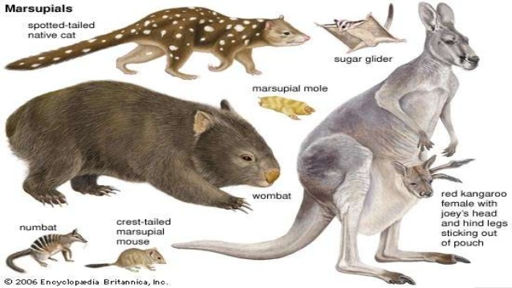

Slide 4
GENERAL CHARACHTERS
Hair-clad, mostly terrestrial, air-breathing, warm-blooded, viviparous, tetrapod vertebrates.
Body distinctly divisible into head, neck, trunk and tail.
Limbs 2 pairs, pentadactyle, each with 5 or fewer digits and variously adapted for walking, running, climbing, burrowing, swimming or flying. Hind limbs absent in cetaceans and sirenians.
Exoskeleton includes lifeless, horny, epidermal hairs, spines, scales, claws, nails, hoofs, horns, bony dermal plates, etc.
Skin richly glandular containing sweat, sebaceous (oil) and sometimes scent glands in both the sexes. Females also have mammary glands with teats producing milk for suckling the young.

Slide 6
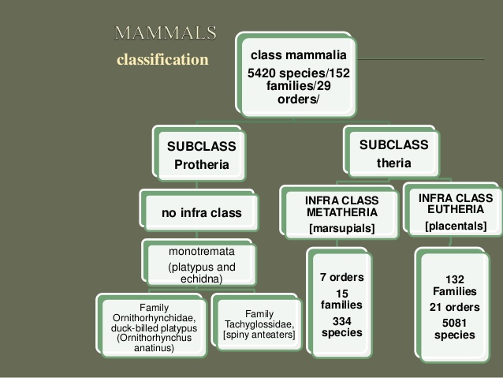

Slide 7
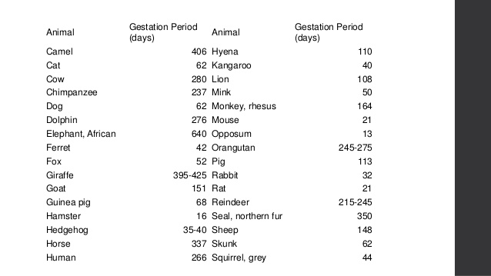

Slide 9
REPTILIA

Slide 10
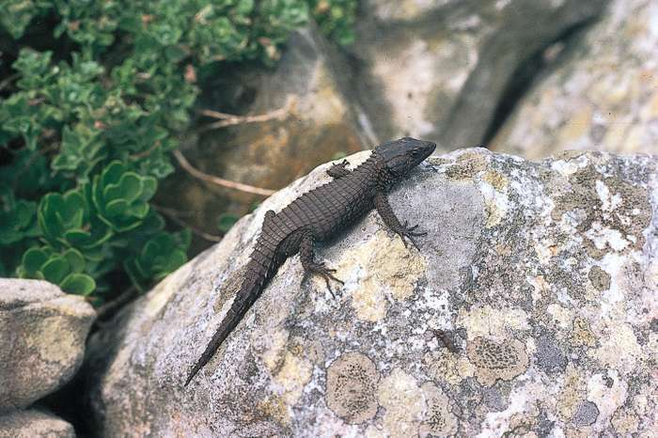
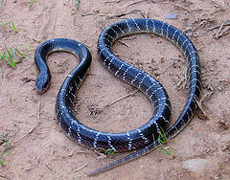
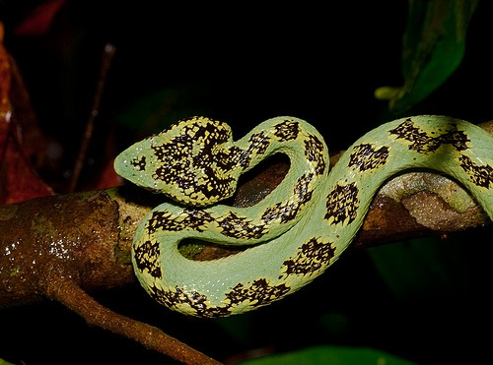
REPTILIA

Slide 11
GENERAL CHARACTERISTICS

Slide 18
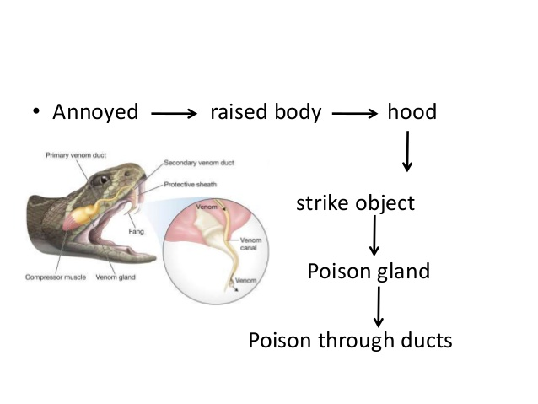

Slide 26
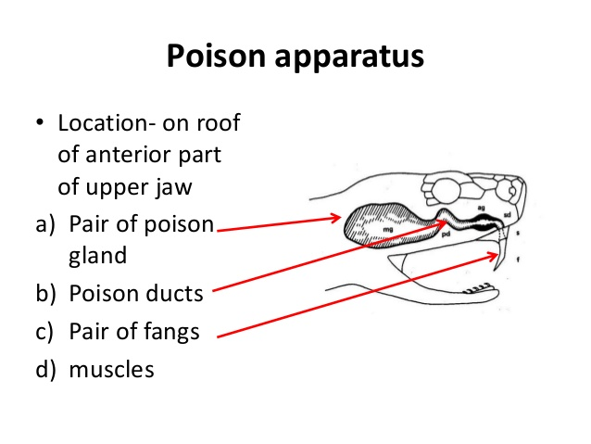

Slide 49
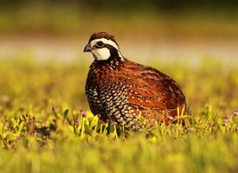
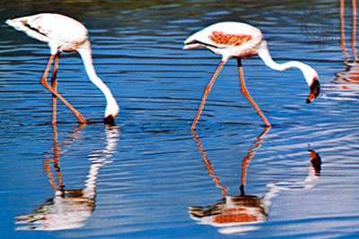
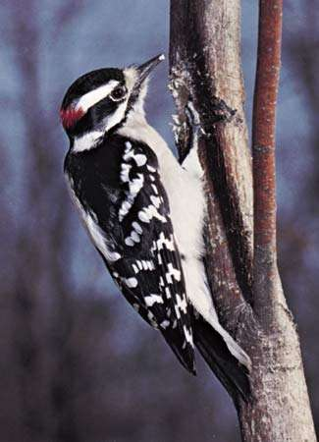
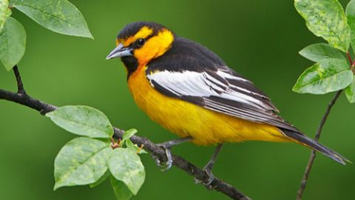
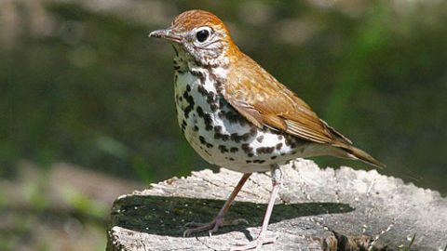
AVES

Slide 52
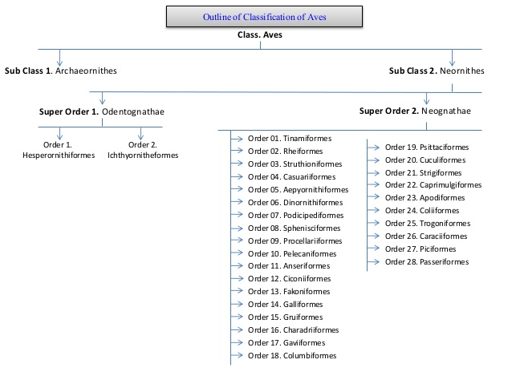

Slide 53
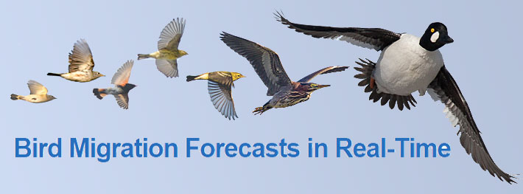
THE BASICS OF BIRD MIGRATION: HOW, WHY, AND WHERE

Slide 54
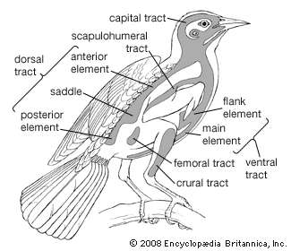
Studying Migration

Slide 55
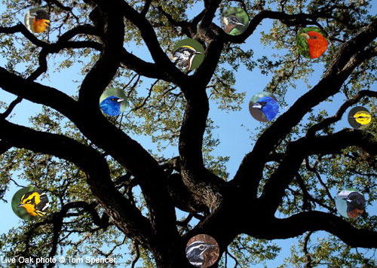
What Is A Migrant Trap? Studying Migration

Slide 56
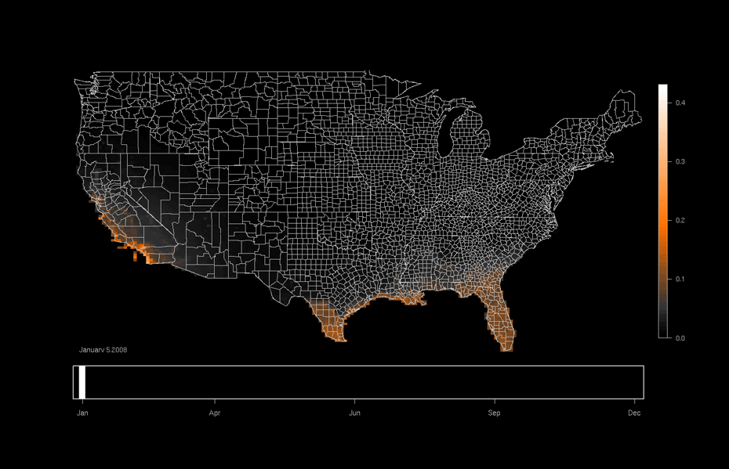
Range Maps

